Slide 1
T2I-Adapter: Learning Adapters to Dig Out More Controllable Ability for Text-to-Image Diffusion Models
C. Mou, X. Wang, L. Xie, Y. Wu, Z. Qi, Y. Shan, and X. Qie, “T2I-Adapter: Learning adapters to dig out more controllable ability for text-to-image diffusion models,” in Proc. 38th AAAI Conf. Artif. Intell. (AAAI), 2024. Available: https://arxiv.org/abs/2302.08453
2025-04-03
Sein Choi
Intelligent Vision Processing Lab. (IVPL)
https://ivpl.sookmyung.ac.kr
Div. of AI Engineering, Sookmyung Women’s University
E-mail: csi1806@sookmyung.ac.kr

Slide 2
T2I
No. | Title | Keyword | Cite
1 | High-Resolution Image Synthesis with Latent Diffusion Models | Text-to-Image Generation, VAE, Diffusion Models, Cross-Attention | Rombach, R., Blattmann, A., Lorenz, D., Esser, P., & Ommer, B.,"High-Resolution Image Synthesis with Latent Diffusion Models," in Proc. the IEEE/CVF Conference on Computer Vision and Pattern Recognition (CVPR), 2022. Available: https://arxiv.org/abs/2112.10752
2 | SDXL: Improving Latent Diffusion Models for High-Resolution Image Synthesis | LDM | D. Podell, Z. English, K. Lacey, A. Blattmann, T. Dockhorn, J. Müller, J. Penna, and R. Rombach, "SDXL: Improving Latent Diffusion Models for High-Resolution Image Synthesis,“, in Proc. the IEEE/CVF Conference on Computer Vision and Pattern Recognition (CVPR), 2023. Available: https://arxiv.org/abs/2307.01952.
3 | Adding Conditional Control to Text-to-Image Diffusion Models | LDM, zero convolution, trainable copy, Image Conditioning | Lvmin Zhang, Anyi Rao, Maneesh Agrawala, “Adding Conditional Control to Text-to-Image Diffusion Models”, in Proc. the IEEE/CVF Conference on Computer Vision and Pattern Recognition (CVPR), 2024. Available: https://arxiv.org/abs/2302.05543
4 | T2I-Adapter: Learning Adapters to Dig Out More Controllable Ability for Text-to-Image Diffusion Models | LDM, Image Conditioning | C. Mou, X. Wang, L. Xie, Y. Wu, Z. Qi, Y. Shan, and X. Qie, “T2I-Adapter: Learning adapters to dig out more controllable ability for text-to-image diffusion models,” in Proc. 38th AAAI Conf. Artif. Intell. (AAAI), 2024. Available: https://arxiv.org/abs/2302.08453
5
6

Slide 3
Contents
Introduction
T2I-Adpater
Ablation Study
Model Optimization
Training & Experiment
Conclusion & Limitation
Sampling

Slide 4
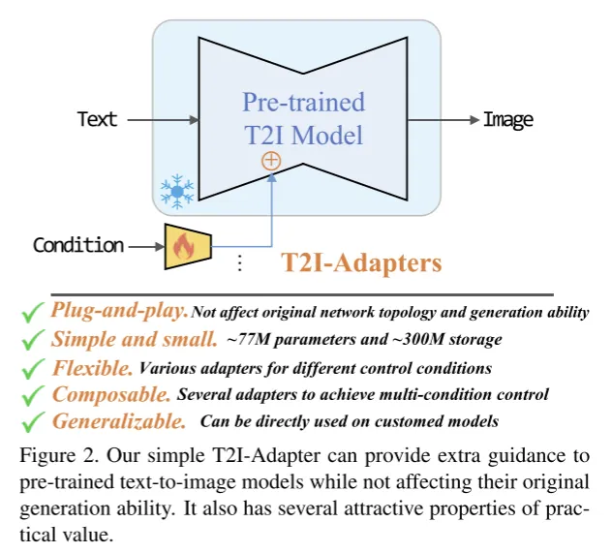
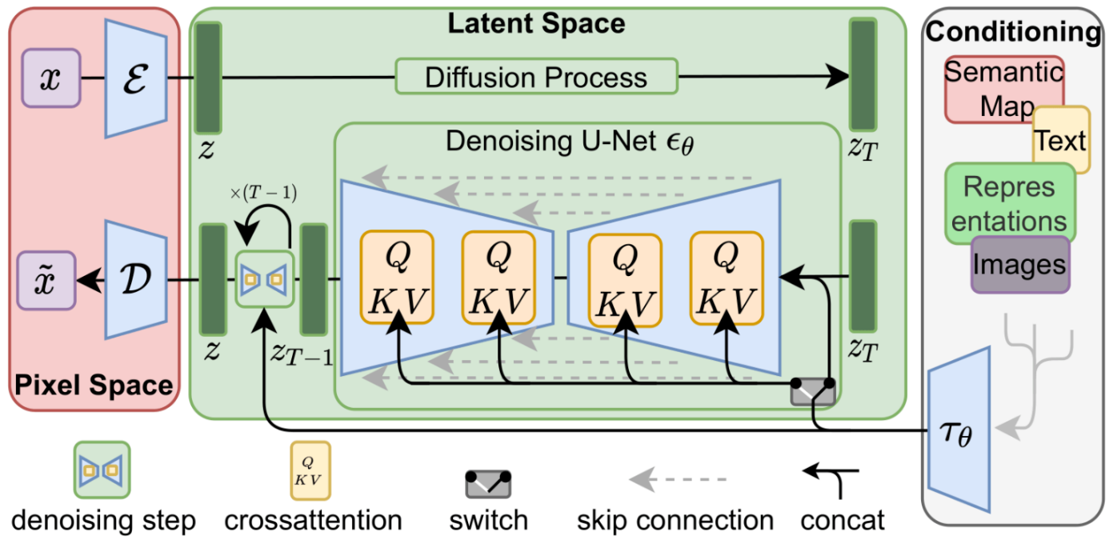
Introduction
Text cannot provide accurate guidance
Issues with text prompts - They do not provide accurate generation guidance that can fully align the internal knowledge of SD with external control.
Solve “alignment” issue – T2I internal knowledge & external control signal
Notes:
Text cannot provide accurate guidance
text prompt의 문제점 :SD의 internal knowledge(내부 지식)과 external control(외부 제어)를 fully aligned(완전히 정렬)할 수 있는 정확한 generation guidance를 제공하지 못하기 때문.
Fully Aligned란? internal knowledg와 external control이 의미적, 구조적으로 일치해야 함. token 간 attention 균형이 불균형이거나 cross-attention 키랑 값이 불일치할 경우 aligned 하지 않음.

Slide 5
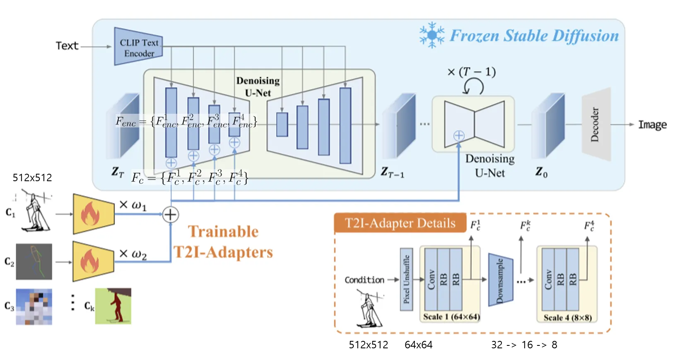
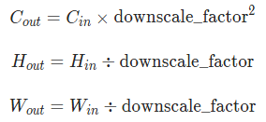
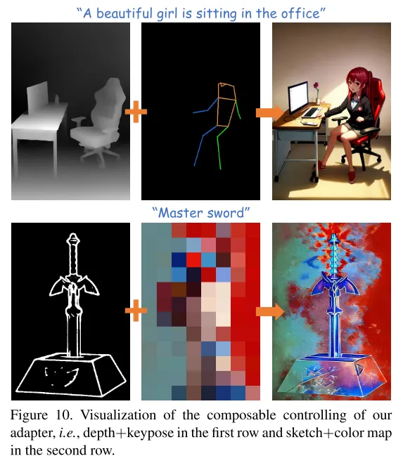
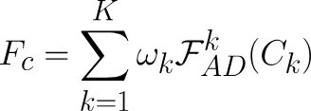
T2I-Adapter
pre-trained SD model (frozen) + several T2I-Adapters (activate)
cf. Pixel Unshuffle
Notes:
512 사이즈 컨디션에 적용하는 Pixel Unshuffle이란
pytorch에서 제공하는 함수로, tensor의 픽셀을 재배열해서 해상도 줄이고 채널 수를 늘리는 연산.

Slide 6
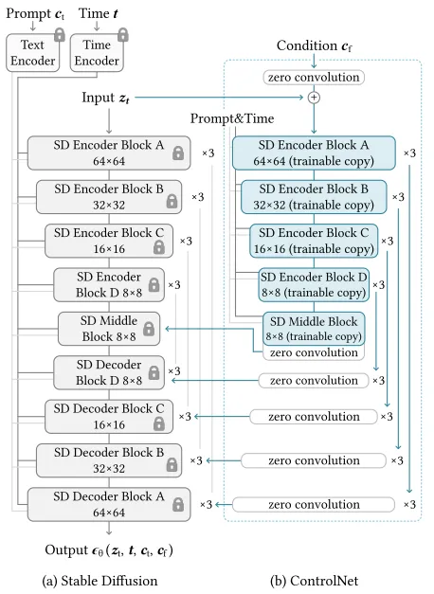
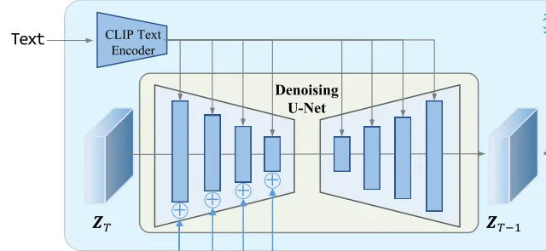
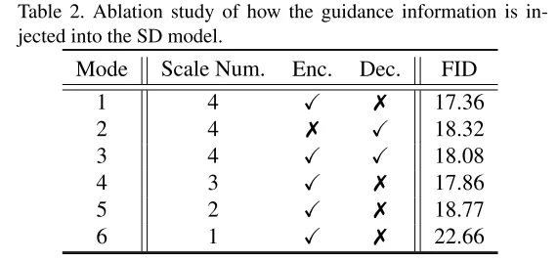
Ablation Study
cf. ControlNet Structure
Guidance Mode
(4 ResNet + 2 ViTs)

Slide 7
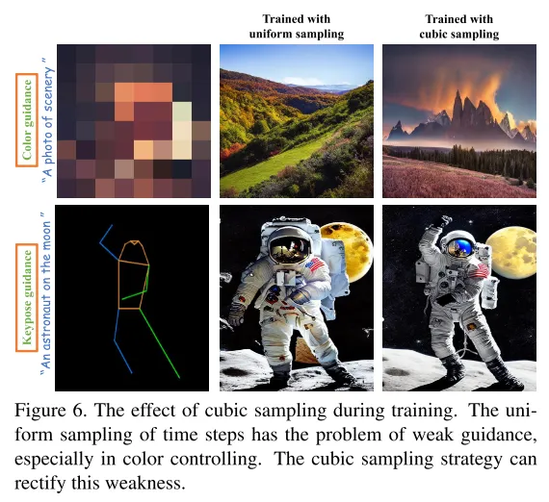
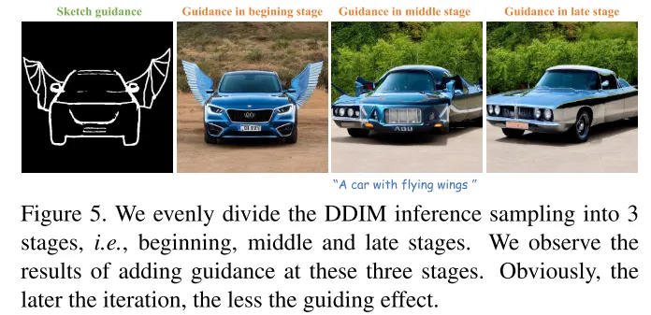
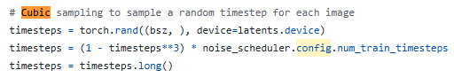
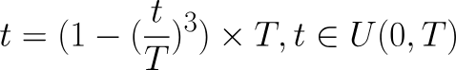
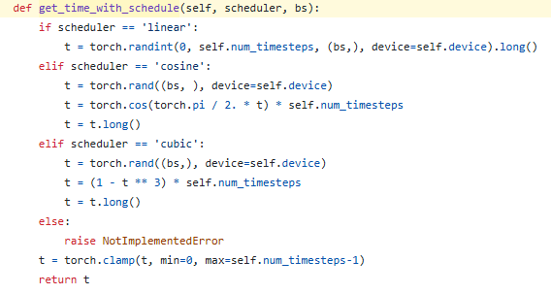
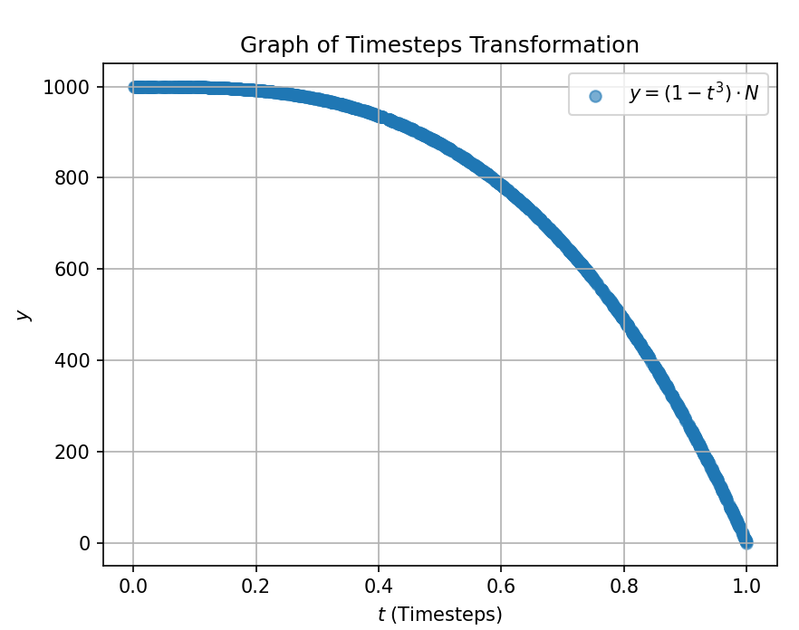
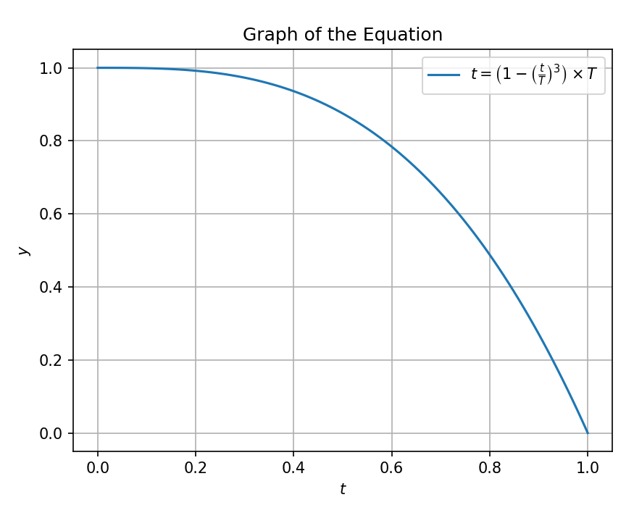
Model Optimization
Optimization function
Cubic function
cf. ControlNet function
https://github.com/TencentARC/T2I-Adapter/blob/main/train_sketch.py
https://github.com/TencentARC/T2I-Adapter/blob/7056c7fb080afc55ce246b2e8b5d0488977fc72f/ldm/models/diffusion/ddpm.py#L808
T2I-Adapter/ldm/models/diffusion/ddpm.py
Notes:
Non-uniform time step sampling during training., -- Cubic function 얘기
샘플링할 때 time embedding도 중요함.
발견한 점 : adapter에 time-embedding을 추가하면 guidance ability를 높이는 데 도움이 된다.
문제점 : 이 추가 방법은 simple and small motivation을 충족 못시킴
sampling
논문의 주장은
초반에 sampling 횟수를 늘려야 == 초기 샘플링 단계에서 falling할 확률을 높여야 guidance 정보를 효과적으로 줄 수 있음
X축: 샘플링 단계 (예: timesteps 또는 iteration).
Y축: falling 확률 또는 노이즈 감소율.
그래프가 초반에 급격히 감소하는 형태라면, 이는 초기 단계에서 더 많은 샘플링이 이루어져 guidance 정보를 효과적으로 전달하고 있다는 것을 나타냅니다.

Slide 8
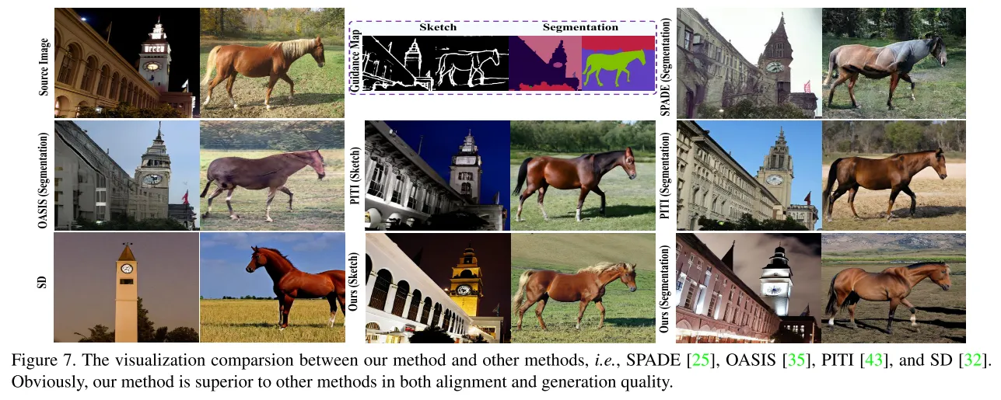
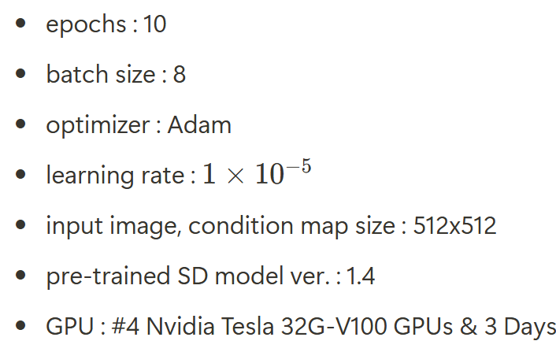
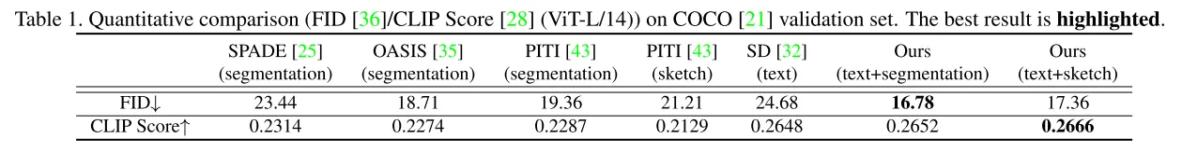
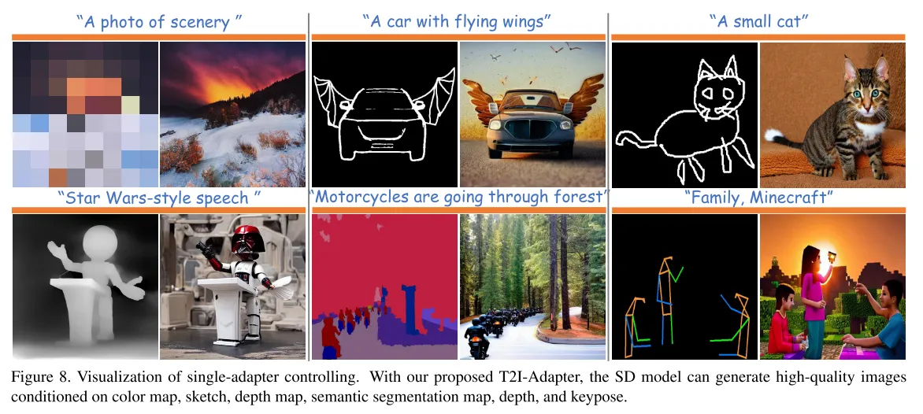
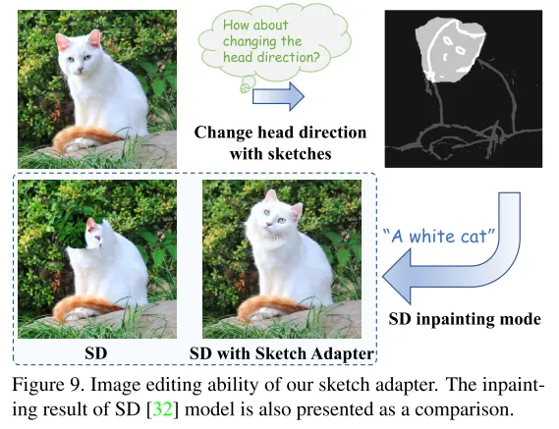
Training & Experiment
Training details

Slide 9
Conclusion & Limitation
Conclusion
Simple and lightweight design
Easily attached in a modular format
Various multi-adapter guidance are possible
Available image editing
Limitation
Multi-adapter guidance must be done manually

Slide 10
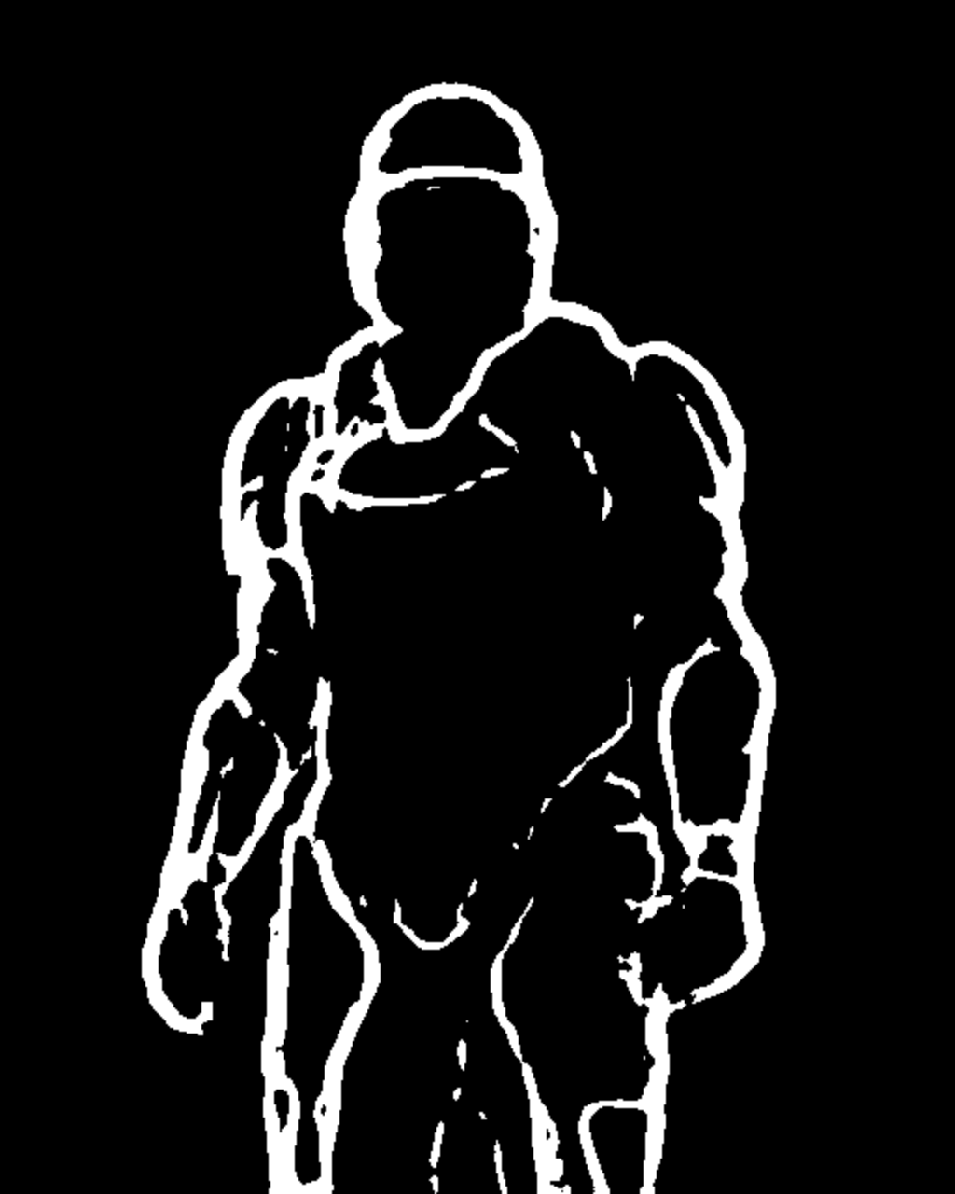
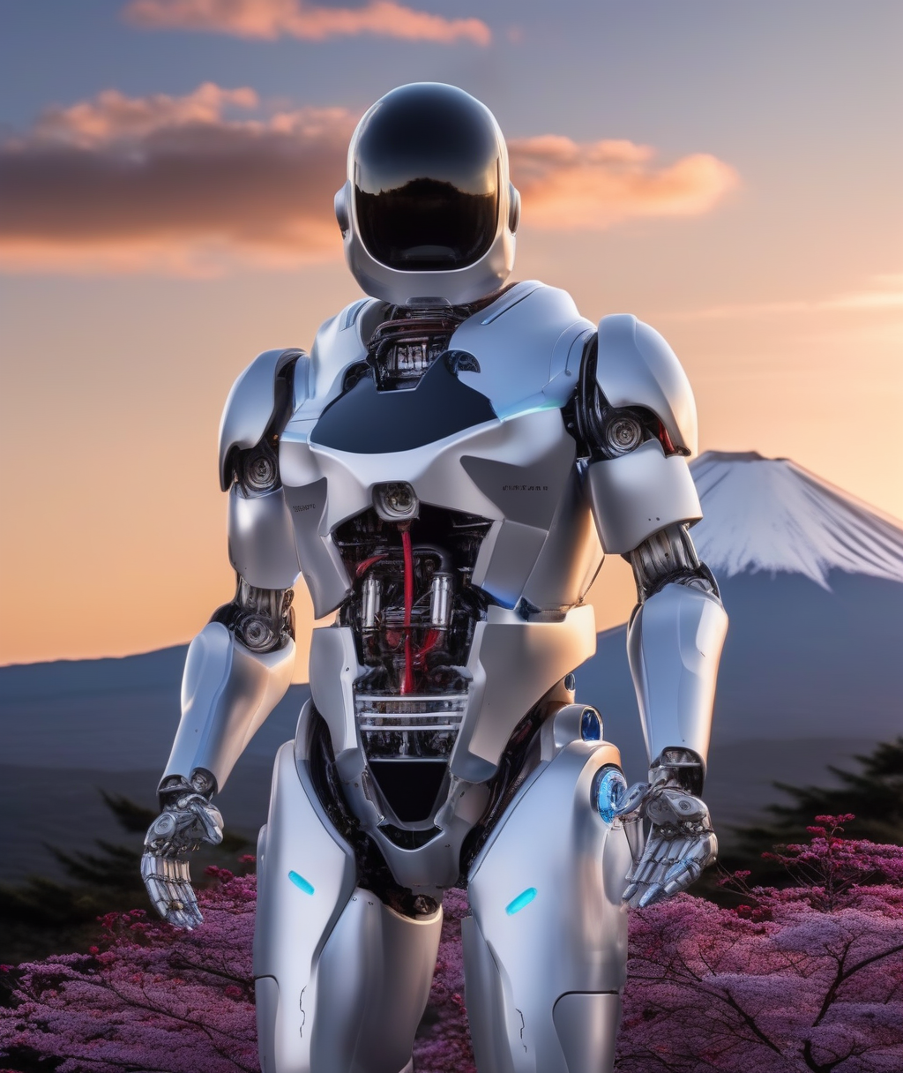
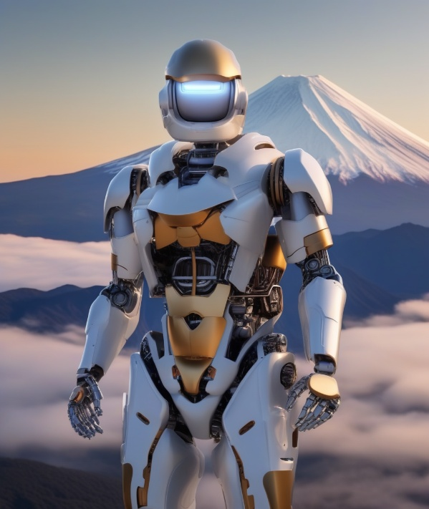
Sampling
Sketch conditioning
prompt = "a robot, mount fuji in the background, 4k photo, highly detailed"
negative_prompt = "extra digit, fewer digits, cropped, worst quality, low quality, glitch, deformed, mutated, ugly, disfigured“
sampling resolution : 1024*1024
GPU memory usage : 9.7G
Sampling time : 3min (30 inference step)
sampling output
example

Slide 11
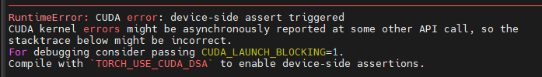
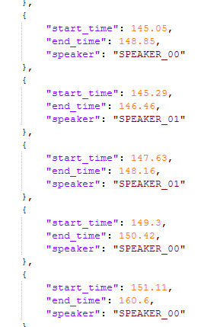

Slide 12
Thank you for your attention.!!!
QnA

